Slide 1
FINITE DIFFERENCE METHOD
Presented by:
Misson Khand (22015)
Romanch Nyaupane (22048)
Submitted To
Dr. Saraswati Acharya
Asst. Prof. Department Of Mathematics
May 26, 2023

Slide 2
INTRODUCTION
The finite difference method is a numerical technique used to solve boundary value problems by approximating derivatives using finite differences
A boundary value problem is a mathematical problem that involves finding a solution to a differential equation subject to specified conditions at the boundaries of the domain.

Slide 3
FORMULA
y_{n-2}(2 – hp_{n-1}) + y_{n-1}(−4 + 2h²q_{n-1}) + y_{n} (2 + hp_{n-1}) = 2h²r_{n-1}
Substituting boundary conditions y₀ = a and = y_{n} = b and solving the system of equations, we get required solution.
i = 1 : y₀(2 – hp₁) + y₁(−4 + 2h²q₁) + y₂ (2 + hp₁) = 2h²r₁
i = 2 : y₁(2 – hp₂) + y₂(−4 + 2h²q₂) + y₃ (2 + hp₂) = 2h²r₂
i = 3 : y₂(2 – hp₃) + y₃(−4 + 2h²q₃) + y₄ (2 + hp₃) = 2h²r₃
· · · · · · · · · · · · · · ·

Slide 4
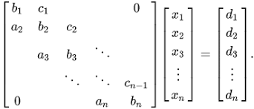
FORMULA
Since y₀ and y_{n-1} are constants, we obtain a tridiagonal matrix from the system of equations at left hand side of equation as:
a = 2-hp (sub-diagonal vector)
b = -4+2h²p (diagonal vector)
c = 2+hp (super diagonal vector)
d=2h²r (RHS vector)

Slide 5
EXAMPLE
y'' - y = x(x-4) : y(0)=0 , y(4)=0

Slide 6
MATLAB CODE
The code is divided into two sections. One is program section and another is a function section that is called during the runtime of the program.
The Program section contains the main program code.
The function section Includes the definition of tridiagonal matrix algorithm which is key component of the implementation

Slide 7
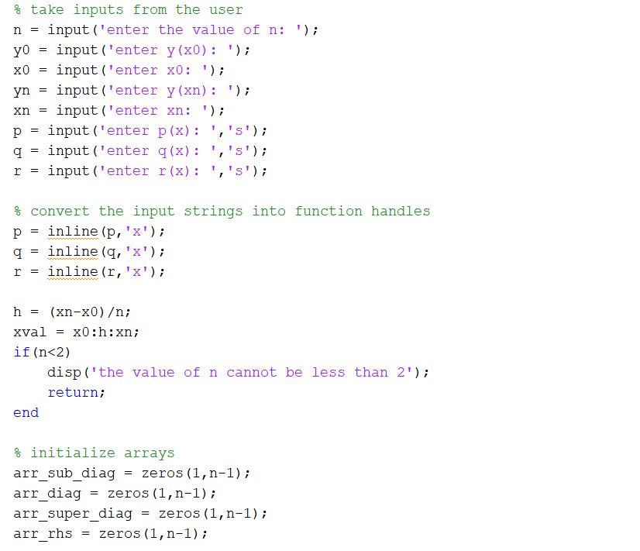
PROGRAM SECTION

Slide 8
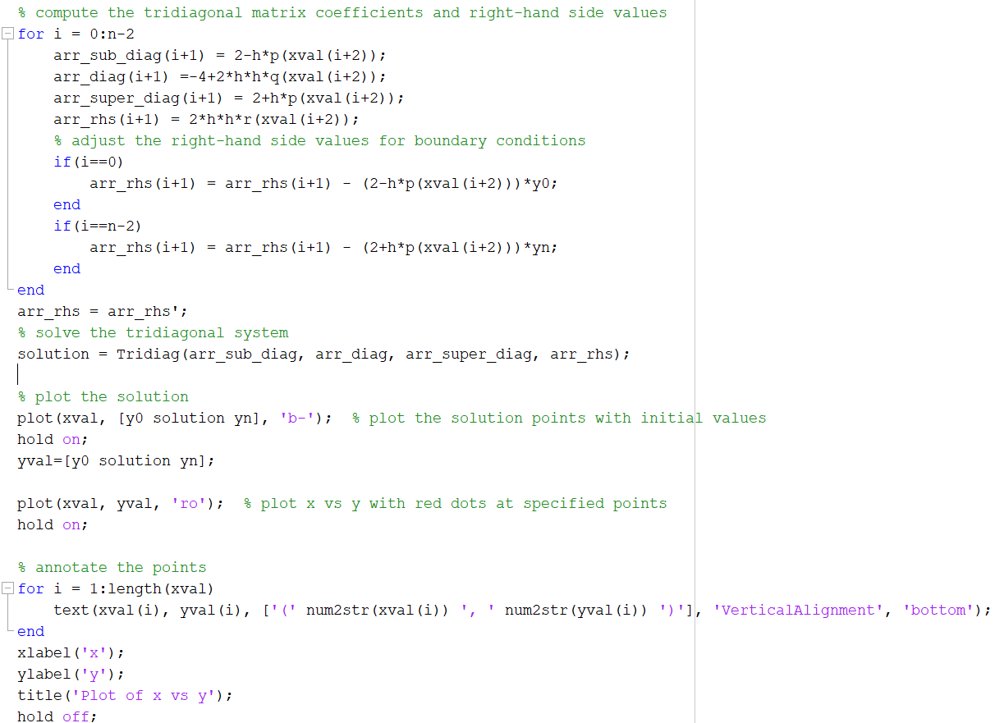
PROGRAM SECTION

Slide 9
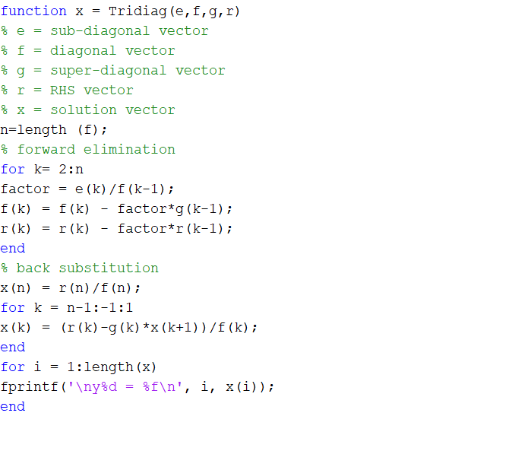
FUNCTION SECTION

Slide 10
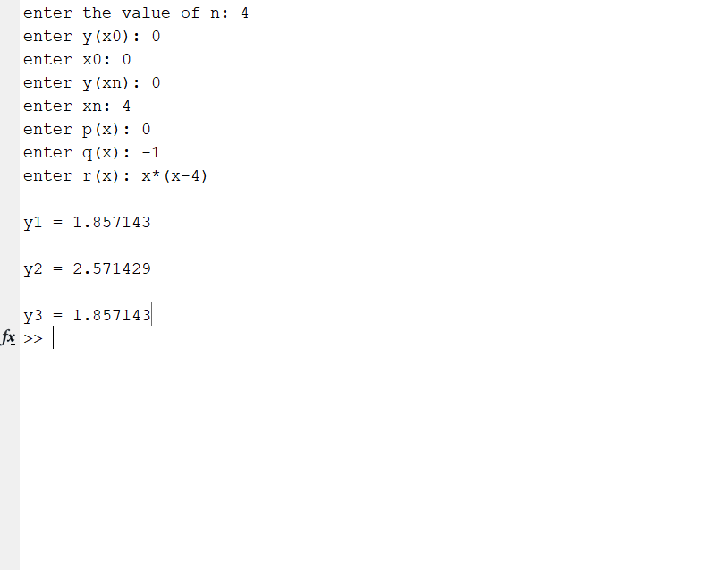
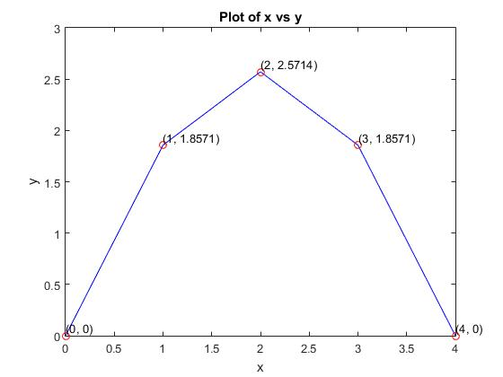

OUTPUT
Solution for the ODE $\frac{ⅆ^{2}y}{ⅆx^{2}}$ -y = x(x-4):
At n=4, we obtained y₁=1.857, y₂=2.5714, y₃=1.857
Fig: plot of solution of y'' - y = x(x-4) at n=4

Slide 11
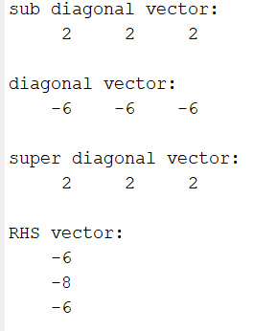
OUTPUT
The program generates the following diagonal and RHS vectors as shown below
The function takes the sub-diagonal (e), diagonal (f), super-diagonal (g), and right-hand side (r) vectors as input

Slide 12
OUTPUT
The function then performs forward elimination, adjusting the diagonal and right-hand side vectors to incorporate the influence of the sub-diagonal elements.
Then, the code performs back substitution, starting from the last element and working backward to calculate the unknowns.
The modified diagonal and right-hand side vectors are used in the back substitution step to obtain the correct solutions and display the output

Slide 13
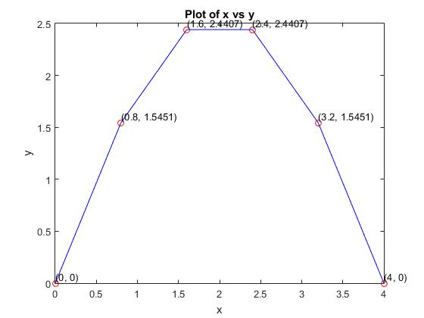
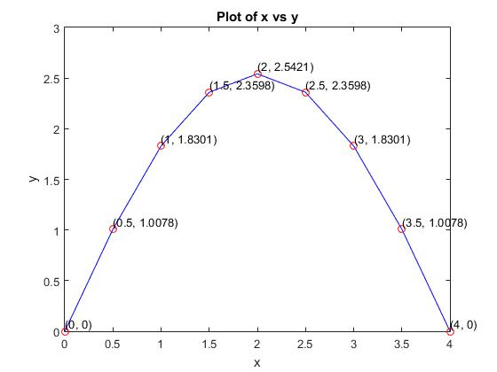
OUTPUT
Fig: plot of solution of y'' - y = x(x-4) at n=5
Fig: plot of solution of y'' - y = x(x-4) at n=8

Slide 14
CONCLUSION
In conclusion, this project successfully implemented the tridiagonal matrix algorithm to solve a second-order linear ordinary differential equation. The result of the calculation done manually and the result of the calculation of implemented program match with each other. Also, we can verify an increase in accuracy with an increase in discretization of the domain. Thus, it can be concluded that the implementation of the program in MATLAB is successful.

Slide 15
…thank you …

